Slide 1
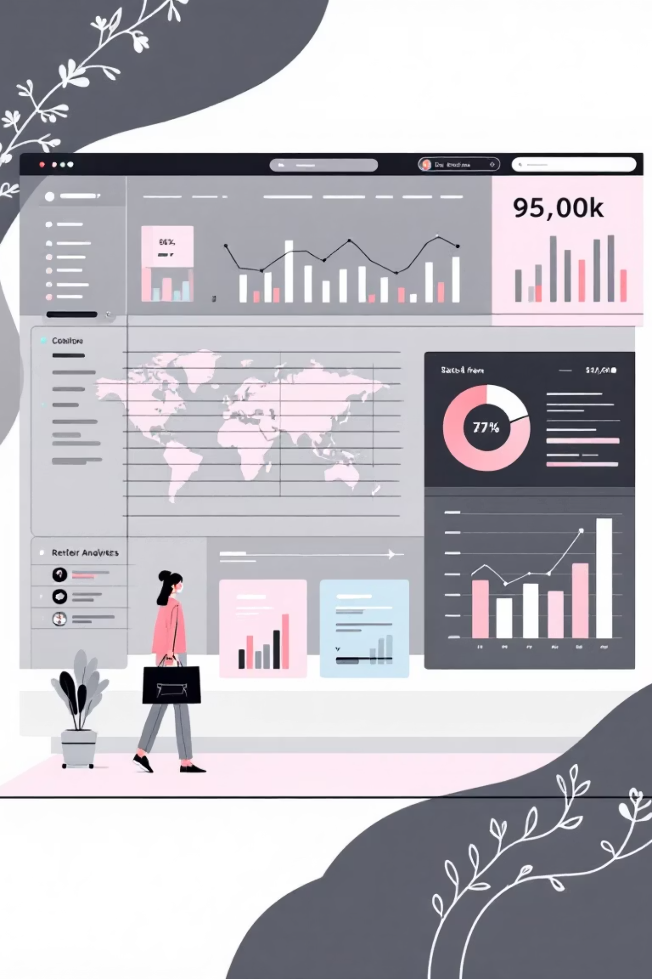
Customer Shopping Behavior Analysis
Uncovering insights from 3,900 purchases to drive strategic business decisions

Slide 2

DATASET OVERVIEW
The Foundation
3,900
18
37
Total Purchases
Data Points
Missing Values
Transactions analyzed
Features per transaction
In review ratings only
Customer Data
Transaction Data
Demographics & location
Product details & pricing
Subscription status
Discounts & promotions
Purchase history
Shipping & ratings

Slide 3
PYTHON ANALYSIS
Data Preparation Pipeline
01
02
03
Data Loading
Missing Data
Feature Engineering
Imported dataset using pandas for initial exploration
Imputed review ratings using category median values
Created age groups and purchase frequency metrics
04
05
Standardization
Database Integration
Renamed columns to snake case, dropped redundant fields
Connected to PostgreSQL for advanced SQL analysis

Slide 4

KEY INSIGHTS
Revenue by Gender
Analysis reveals spending patterns across gender segments, identifying opportunities for targeted marketing campaigns.
Understanding gender-based preferences drives personalized customer experiences

Slide 5

High-Value Discount Shoppers
Smart Spenders
Strategic Opportunity
Customers using discounts while maintaining above-average purchase amounts
Prime segment for loyalty programs and exclusive offers
Revenue Potential
High lifetime value with promotional engagement

Slide 6


Product Performance Insights
Top-Rated Products
Shipping Preferences
Five products achieved highest average review ratings, indicating strong customer satisfaction and quality perception.
Express shipping users show different spending patterns compared to standard shipping customers.

Slide 7



SUBSCRIPTION ANALYSIS
Subscribers vs. Non-Subscribers
68%
2.3x
85%
Higher Average Spend
Revenue Multiplier
Retention Rate
Subscribers spend more per transaction
Total revenue from subscriber segment
Subscribers show stronger loyalty
Customers with >5 purchases are significantly more likely to subscribe

Slide 8



Customer Segmentation
Loyal
Returning
New Customers
Classification based on purchase history reveals three distinct customer tiers, each requiring tailored engagement strategies.
Revenue by Age Group
Discount Dependency
35-44 age group contributes highest revenue, followed by 25-34 segment
Five products show highest percentage of discounted purchases

Slide 9

POWER BI
Interactive Dashboard
Comprehensive Power BI dashboard visualizes all key metrics, enabling real-time decision-making and trend monitoring across customer segments.

Slide 10





ACTION PLAN
Strategic Recommendations
Boost Subscriptions
Promote exclusive benefits to convert high-frequency buyers
Loyalty Programs
Reward repeat buyers to advance them into loyal segment
Optimize Discounts
Balance promotional sales with healthy profit margins
Targeted Marketing
Focus on high-revenue age groups and express shipping users
Product Positioning
Highlight top-rated items in marketing campaigns

